Slide 1
MCCP6020
Advanced English for Academic Purposes
Session 3
Describing Research Methodology
Presenting and Discussing the Research Results (Part 1)

Slide 2
Learning Outcomes:
By the end of this session, students should be able to:
identify the key components of the Methods section/chapter of a journal article and a thesis
deploy appropriate linguistic strategies to describe the research methodology
present and discuss the research results in an organized manner
deploy appropriate linguistic resources to present and discuss research results
make reasonable claims in the Discussion section/chapter of a journal article and a thesis

Slide 3
Warm-up Task
Find a partner and discuss the following questions:
1. What are the main components of the ‘Methodology’ section/chapter of a journal article and a thesis?
The details included in the methodology section and the order in which they are presented are not fixed. The following includes several of the conventional components:
• overview of the research/experiment
• research strategy (Why you have chosen a particular strategy but not possible alternatives)
• data collection (population/sample e.g. animals, chemicals, location, context, sampling technique, procedures, materials, variables)
• framework for data analysis (e.g. statistical treatment, data analysis methods)
• limitations and potential problems (Is your research valid and reliable? How can you minimize any limitations?)

Slide 4
Warm-up Task
2. Do you think the following statements about the ‘Methodology’ section/chapter are true or false?
 | True | False
1. The aim of the Methodology section/ chapter is to document every single step the researchers took in the research.
2. Based on the steps detailed in the Methodology section/chapter, other researchers should be able to replicate the research.
3. Other researchers should be able to evaluate the reliability and validity of the research after reading the Methodology section/chapter.
X
X
X

Slide 5
The diagram below shows how a particular view of the world reflects the whole research process. By setting out the interrelationship between what researchers think can be analyzed (ontological position), linking it to what researchers can actually know about it (epistemological position) and how to go about acquiring it, it is possible to comprehend the impact on what or how you decide to study the problem. However, it is important to note that ultimately you need to identify the research strategy that best meets your research objectives.

Slide 6
The Directional Relationship between Key Components (the building blocks) of Research
Ontology
Epistemology
Methodology
Methods
Sources
What is out there to know?
What and how can we know about it?
How can we go about acquiring that knowledge?
What precise procedures can we use to acquire it?
What data can we collect?

Slide 7
Methodology vs. Methods
Methodology refers to a theory or framework in which the researcher is taking (e.g. quantitative or qualitative), and the argument that is given to justify choices made in the theory as well as the specific method(s) selected. It requires a clear explanation and rationale. Some parts are quite theoretical or academic (making reference to other studies or books/articles on research methods), while other parts are more practical (how to).
Method(s) refers to actual research instruments and participants/materials used (e.g. interviews or discourse analysis, lab equipment, statistics, etc.). Writers need to justify why each method was chosen, and not others (justify choices by using the literature).

Slide 8
Researchers who examined the moves of the Methods sections in various disciplines have proposed the Demonstrating Rigour and Credibility (DRaC) move/step model to explicate the general roles of the Methods section: Orientation (referencing previous works, providing general information), description (of setting, subjects, data, tools, variables); demonstration (of experimental procedures and data analysis); argumentation (when rationalizing decisions); and persuasion (when rationalizing data processing/analysis). They argue that, in fact, it is the nature of research, not the rhetorical conventions, that determines how you should describe and explain your research methodology.

Slide 9
Rhetorical Moves | Writing Actions
Move 1: Research aims / questions / hypotheses (Optional) | Stating the research aims / questions/ hypotheses (optional)
Move 2: Describing research design (Optional) | Outlining the vital aspects of the research design
Move 3: Describing data collection or experimental procedures (Obligatory) | Describing research context (optional) Describing the sample (conventional) Describing instruments (optional but conventional) Elaborating on data collection/experimental procedures (obligatory) Justifying data collection procedures (optional) Verifying compliance with ethical standards (optional)
Move 4: Describing data analysis procedures (Conventional) | Recounting data analysis procedures (conventional) Justifying data analysis procedures (optional) Demonstrating accuracy of data analysis (optional)
Move 5: Describing limitations (Optional) | Explaining possible limitations of the research design (e.g. research context, sample size, data collection instruments, data collection procedures, data analysis methods) (optional)
The following table summarizes the common rhetorical moves in the Methods section.

Slide 10
Peacock (2011) studied the structure of the Methods section in 288 research articles across eight disciplines. The table below summarizes his findings:

Slide 11
Task 1
Now refer to a journal article in your discipline you have recently read and identify the key components and the moves in the Methods section. Share your findings with a partner and discuss why there might be some differences in the components and the order of information in the Methods section of different research.
The general rules for the Methods section are that:
the text should be organized in a highly logical manner;
the information provided should allow researchers to repeat the research described;
an appropriate amount of details should be included; and
clear justifications for the choices of methods should be provided.

Slide 12

Task 2
Read the following example of the Methods section from a journal article in the Journal of Neurochemistry. In groups of 3-4, analyze the language features (e.g. tenses, active/passive voices, sequencers, and sentence structure). Based on your group’s analysis, summarize the common language features in the Methods section.
What are some common language features in the Methods section? Ask ChatGPT to analyse the structure and language features of the ‘Method’ section of a journal article of your discipline.
Feature 1: In the methods section, it is customary to use the simple past tense to describe what you did in your study.
Although the past tense is predominately used in the Methods section to describe the actions done by the researchers, the present tense is also used in this section to describe facts and to refer to figures or diagrams. For example:
Addition of a bright field image allowed separation between neurons and glia, that are visibly different and are situated on different focal planes.
Figure 1 shows…

Slide 13
Note that the present tense is also used when one follows a fixed/standard set of procedures of doing experiments. This is often seen in publications of science and technology. The choice and use of the simple present is to show that the author’s data is obtained strictly through the accredited scientific procedures and therefore, the reliability should be unquestionable. This situation may be particularly applicable to science students, computer students and students of traditional Chinese medicine. See the example below:
Methods Regression and decomposition methods Our adiposity measures are initially modelled by linear regression, estimated using ordinary least squares (OLS). Regression models are first estimated using age, gender and regional dummies (Specification 1). We then enhance this specification by adding obesogenic small-area level characteristics (Specification 2). Our full specification is further augmented by individual-level socio-economic position (SEP) and lifestyle covariates (Specification 3). We also estimate unconditional quantile regression models (UQR) that allow us to consider… Source: Davillas, A., & Jones, A.M. (2020). Regional inequalities in adiposity in England: distributional analysis of the contribution of individual-level characteristics and the small area obesogenic environment. Economics and Human Biology, 38, 1-13.

Slide 14
Feature 2: The passive voice is often used in the Methods section. For example:
Fluorescent images were acquired with a frame interval of 10s. After the above procedure, data were analysed using software from Andor IQ (Belfast, UK).
However, the passive voice should not be the default in the Methods section. It always depends on whether you would like to emphasize what was done (passive) or who did it (active). Sometimes active voice can make the writing more concise and flow more smoothly. Also, some influential journals (e.g. Science, Nature, British Medical Journal) prefer writers to use the active voice. Read the Instructions to Authors for the journal you intend to submit your paper to.
Feature 3: Sequencers are used to describe the steps of actions in the experimental procedure. For example:
First, rat brains were quickly removed and macerated in chilled Ca2+‐free HBSS (Invitrogen). Then, the tissue was minced and trypsinized (0.1% for 15 min at 37°C), triturated and plated on poly‐d‐lysine‐coated coverslips and cultured in Neurobasal A medium (Gibco‐Invitrogen, Paisley, UK) supplemented with B‐27 (Gibco‐Invitrogen), 2 mM l‐glutamine and 1% Penicillin/Streptomycin.
After the above procedure, data were analysed using software from Andor IQ (Belfast, UK).

Slide 15
Feature 4: The ‘To+infinitive’ construction is used to express purposes or provide justifications. For example:
To avoid accumulation of oxidized products, HEt was not preloaded to the cells, but was added to the solutions in the beginning of the experiments in primary co‐cultures.
To assess lipid peroxidation, C11‐BODIPY (581/591, 2 μM, Molecular Probes) was excited using the 488 and 565 nm laser and fluorescence measured from 505 to 550 nm and above 580 nm (40× objective).

Slide 16
Initial Purpose Clauses or Phrases
In an effort to evaluate…
In order to establish…
To further test this hypothesis, …
To determine the cost, …
In the interest of obtaining useful data, …
Phrases Making Temporal Links
During the data collection, …
Prior to collecting this information, …
On arrival on campus, the participants…
In the follow-up phase of the study, we…
After the interview, subjects were…
Causal or Connective Phrases
Based on the feedback from the pilot study, …
On the basis of the literature review, …
Because of privacy issues, we…
In spite of these issues, we…
In light of these unexpected findings, …
Here are more linking phrases that operate to tie ideas together in the Methods section and to add some stylistic variety.

Slide 17
Task 3
Fill in the blanks in the following Methods section from a journal article in the Journal of Social Sciences using the correct tenses and voices.
2. Methods
2.1. Design and Procedure
We _____________ (make) an initial panel of 113 items, based on literature of social work practice with families, including aspects such as collaborative and narrative models, common factors that explain changes in psychosocial interventions, and the interprofessional collaboration with larger systems. A two-step process revision of the initial panel __________________ (carry out), and eventually, 67 items were chosen. The first stage _______________ (complete) by two social workers with more than 15 years’ experience in community basic social services. The second stage of the revision _________________ (implement) by four full time professors at the University of Illes Balears (Spain), all with previous experience in social work with FED.
made
was carried out
was completed
was implemented

Slide 18
2.2. Instruments
Two instruments were applied: an Inventory of Collaborative Practices in Social Work with FED, and a sociodemographic questionnaire specifically designed for this study. The 67 intervention criteria of this Inventory _____________ (refer) to the different skills, attitudes, and relational stances that the literature conveys as fundamental for carrying out collaborative practices in social work (basic social services), not only with families in special distress but also with larger systems involved with them. Thus, among others, there are items related to the construction of a helping relationship, the importance of a relational stance as an appreciative ally, reflection with the family about the intervention of different professionals at the same time, or the co-construction of objectives and tasks with the clients. Participants ________________ (ask) to assess the level of importance of each item and the level of implementation in their current practice. A five-point frequency scale was used (5 = extremely important/always, 4 = very important/very often, 3 = important/often, 2 = not very important/sometimes, and 1 = not important/hardly ever).
refer
were asked

Slide 19
Participants also ______________ (fill out) a socio-demographic questionnaire, including questions on gender, age, and issues related to their specific workplace (such as supervision or spaces for interprofessional coordination). This survey __________________ (conduct) between June and October 2018. A list of 146 social workers in public basic social services in Mallorca (Spain) provided the sampling frame for this study. The participants worked in different municipalities across Mallorca. Public basic social services provide a range of services for individuals, families, and groups. Act 4/2009 (Illes Balears, Spain) ____________ (establish) the basic social services to be offered by the regional administration. Thus, social workers attend to different kinds of requests, and they provide information, counseling, and support, together with resource management guidance. These professionals attend FED and work with them at different levels: (a) individual, including with economic difficulties, social isolation, and professional insertion; (b) family-relational, including with the management of the household economy, parenting abilities, the improvement of relationships, relationships with larger systems involved in their lives, and coordination to ensure an integral intervention; and (c) socio-cultural, including with their community connections, their values, and culture.
filled out
was conducted
establishes

Slide 20
The principal investigator PI of the study (T.C.) personally ______________ (contact) each manager of the different services, in order to explain the aim of the present research and to ask for their collaboration in the recruitment of participants. Regarding data collection, participants _______________ (complete) the self-administered questionnaire in their workplaces (during working hours) by prior appointment. The PI was always in the same room, in order to respond any inquiries and to guarantee that there were no interruptions while the questionnaire was being completed. The Ethics Committee of the University of Illes Balears approved the study (70-CER-18).
contacted
completed

Slide 21
2.3. Sample
The sample _____________ (make up) of 121 social workers (mean age = 42 years old; SD = 8.30, range = 23–64; 92.6% females), who carried out their work in public basic social services in Mallorca (Spain). The sample universe was made up of 146 social workers; therefore, the sample ________________ (constitute) 82.88% of the total population under study. The sample was significant, with a 95% confidence level and a 4% margin of error. The inclusion criteria were: (1) having a degree in Social Work; (2) developing their work in basic social services in (location), with at least 2 months in the current service; and (3) currently conducting practice with families in special distress (known as “multi-problem” families).
was made up
constituted

Slide 22
2.4. Data Analysis
The Z Kolmogorov–Smirnov normality test _______________ (conduct) to decide whether parametric or non-parametric tests should be run. This test was conducted for each item of the questionnaire (using as variables the result of subtracting the levels of implementation from the levels of importance). The scores were 0.000 for all the items. This test was also conducted regarding the sociodemographic questionnaire, and as the scores did not exceed 0.05, non-parametric tests were conducted. Univariate descriptive analysis, frequency tables, and the Wilcoxon signed-rank test _____________ (apply) to the answers of participants regarding the Inventory items (both the levels of importance and implementation). Bivariate analyses (Kruskal–Wallis and Mann–Whitney U tests) were applied to analyze the relationships between the questions and answers in the Inventory related to the workplace organization. Statistical analyses __________________ (carry out) using SPSS 20.0.
Adapted from: Casado, T., Riera, J.A., & Cardona, J. (2020). Social work with families in special distress: Collaborative practices. Journal of Social Sciences, 9(7), 121-140.
was conducted
was applied
were carried out
Visit the Academic Phrasebank prepared by University of Manchester for more expressions used in describing Methods in a dissertation and a research article: http://www.phrasebank.manchester.ac.uk/describing-methods/

Slide 23
Task 4
Find a partner and discuss how “presenting” and “discussing” the research results are different. You may comment on the content, structure and language features in these two sections.
“Results” deal with description of the research findings, but “Discussion” deals with interpretations of significant points arising from the findings. The “Discussion” may state the causes for particular results and compare the results with theoretical expectations.
“Results” sections usually include texts, figures, illustrations and tables.
“Results” are usually presented with objective language while “Discussion” is written with more cautious (hedging), and evaluative language.
The past tense predominates in the “Results” section while the present tense is likely to be used in the “Discussion” section.

Slide 24
Task 4
Study the statements below and decide which are from the results (R) or discussion (D) part of a medical journal article on skin cancer in children.
 | Results or Discussion?
1. Our finding of a low skin cancer rate in redheads is unlikely to be due to small sample size.
2. If the relation between melanocytic mole frequency and melanoma risk is the same for children as for adults, then the pattern of risk seems to be established very early in life in Queensland children in the tropics.
3. Children who averaged more than 4 hours per day in the sun were three times as likely to have high numbers of melanocytic moles than were children who spent 1 hour or less per day.
4. It seems that living in Townsville is, in itself, sufficient for children to acquire large numbers of melanocytic moles early in life.
Discussion
Discussion
Results
Discussion

Slide 25
 | Results or Discussion?
5. Children who had at least one episode of sunburn had more than twice as many melanocytic moles compared with children who had never been sunburnt.
6. Melanocytic moles also increased with the total number of hours spent in the sun in the year before examination.
7. Our results suggest that this may be explained by sun-avoidance in the most sun-sensitive group.
8. Significantly more melanocytic moles were associated with light neutral skin colour compared with other skin types ... and with darker hair colour - 28 for red/auburn hair, 30.5 for blonde/fair hair, and 43 for dark hair (p=0.0001).
Results
Results
Discussion
Results

Slide 26
Guidelines for Writing the Results Section of a Thesis and a Journal Article
Although there is greater variability when presenting the results in comparison to the Methodology section, the following guidelines may help secure the communication of sufficient information.
Create an appropriate section/chapter title e.g. “Empirical Researching Findings”, “Data Description, Analysis and Synthesis”, “Experimental Results”, if your results are handled in an explicitly separate section or chapter. If you use a thematic approach in presenting your research results, the “themes” may be used as the section/chapter title. Use headings and subheadings to indicate the progression of content within the section/chapter.
Write a brief introduction to your results/discussion chapter including a) the data you set out to collect; b) the framework for your data analysis and c) the context of your (empirical) research.
Present the main findings concisely, objectively and accurately. The past tense is likely to dominate.
Report your results so as to provide as much information as possible about the nature of the differences or relationships.
Conclude with a statement about the implications.

Slide 27
There are three main moves when writing about research results. The table below shows the typical elements included in the three moves.
Move | Purpose
Presenting metatextual information | Presents preparatory information by: previewing, linking, providing background information, referring back to methodology, pointing to location of tables, figures and graphs
2. Presenting results | Presents results (findings); presents procedures; restates hypotheses or research questions; states what the data are and highlights data for reader’s attention; provides evidence e.g. statistics, examples, frequently presents information visually (e.g. graphs, tables, figures, photographs).
3. Commenting on results | Begins to interpret results and make claims; looks for meaning and significance; may point to contribution to field; makes comparison with previous studies (often for justification of method or procedure); may comment on strength, limitations or generalizability of results. Note: The commentary may be made in a separate ‘Discussion’ section.

Slide 28
Task 5
Read the following extracts of the “Results” section. The first extract presents quantitative data while the second extract presents qualitative data. Discuss with a partner:
How do the two extracts below differ in their approach to presenting quantitative and qualitative results?
What language features are used to present quantitative and qualitative data in the two extracts?

Slide 29
Extract 1
The results of the bivariate analysis (see Table 2) indicated significant associations between digital media exposure, parasocial relationships, collectivism, general political trust, and COVID-19 political trust (r ranged from 0.28 to 0.68, p < .001). To establish the reliability and validity of the study measures, Confirmatory factor analysis (CFA) was used to assess the measurement model and factor loadings of the scale items, and the values of the loadings of the measurement items were greater than the recommended value of 0.50 (see Table 3). We correlated error terms of the same latent variables. The measurement model’s fit was good with the model fit indices locate within an acceptable range:χ2/df = 60.6, p < .001, CFI = 0.942, RMSEA = 0.057, SRMR = 0.039, and TLI = 0.920). The value of the average variance extracted (AVE) for the study constructs (ranging from 0.51 to 0.63) exceeded the threshold value of 0.50, which suggested that the study measures had sufficient convergent validity (Ab Hamid, Sami, & Sidek, 2017). The composite reliability (CR) value of the study constructs (ranging from 0.88 to 0.92) also exceeded the recommended value of 0.70 (Kline, 2016). Besides, the research constructs possessed sufficient discriminant validity with the Pearson correlation between each pair of constructs being smaller than the square root of the AVE estimates (see Table 4). Heterotrait-monotrait (HTMT) analysis was also conducted to assess discriminant validity. The results in Table 5 further confirmed that the discriminant validity of the study constructs was good because the HTMT values were below 0.90 (Gold, Malhotra, & Segars, 2001).
Liu, P. L. (2023). Parasocial relationship in the context of the COVID-19 pandemic: A moderated mediation model of digital media exposure on political trust among Chinese young people. Computers in Human Behaviour, 141, 107639. https://doi.org/10.1016/j.chb.2022.107639

Slide 30
Extract 2
Migrant men doing desire in between native home and destination community
For the young and single migrant men we interviewed, leaving home and migrating to cities meant much more than merely finding employment. They saw migration as a journey and an opportunity to open the doors to affluent urban life; and its increasingly Westernised values of love, romance, and sex (Ma and Cheng 2005). It also meant new-found freedom and the opportunity to pursue individual intimate desires in a manly and appropriate urban manner. For these migrant men, migration entailed being away from home and escaping parental scrutiny, as well as gaining control in their choice of intimate partners. The factories in which they worked provided abundant opportunities for them to meet intimate partners of the same age. The wide range of entertainment and leisure venues in urban areas gave them space for dating. However, dating was a gendered activity to meet the urban normative ideal of manhood, young migrant men were expected to take an active role and foot the bill in the dating process. They were forced to compete with rich urban men who often enjoyed a higher social status and more financial resources. The close association between dating, consumption, and economic power in urban areas forced young migrant men, who were often economically insecure, to confront their class disadvantages as compared with local men. Mak, a 30-year-old migrant security guard, argued that he ‘lost’ his girlfriend to a rich urban man because of his disadvantaged socio-economic status:

Slide 31
  Girls like you when you have money and they dump you when you don’t have money ... I used to have a girlfriend who swore that she was determined to marry me. She insisted that if we had children she would keep it ... but when she got a job selling beer in a glamorous night club, she met rich men who visited her every night and she changed her heart ... she aborted our baby without informing me ... I have no job prospect, I have no money. Rich men like her ... at the end she went with a Hong Kong man.
Young migrant men broke up with their girlfriends when they realised that they could not afford to entertain and support the consumption practices of their female partners. Alternatively, their relationships were terminated because their lovers decided that they lacked the material means to qualify as marriageable men. Migration thus exposed young migrant men such as Mak to the urban normative ideal of manhood through sexual pursuits buttressed by financial capital but simultaneously precluded these men from gaining access to the wealth and income that was central to its realisation (Choi and Peng 2016).
Susanne Y. P. Choi (2019) Migration, masculinity, and family. Journal of Ethnic and Migration Studies, 45(1), 78-94. DOI: 10.1080/1369183X.2018.1427562

Slide 32
3. Now refer to the ‘Results’ section of a journal article in your own discipline. How are the ‘Results’ presented? What language features do you notice?
How are the ‘Results’ presented? (e.g. use of tables and diagrams, structure results around hypotheses or group findings thematically) | What language features do you notice? (e.g. tenses, word choices, hedging phrases, verbs, objective vs evaluative language)

Slide 33
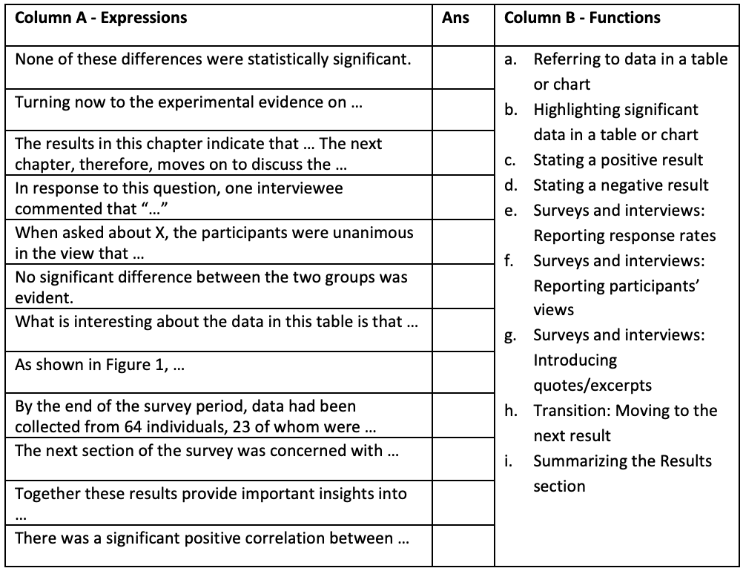
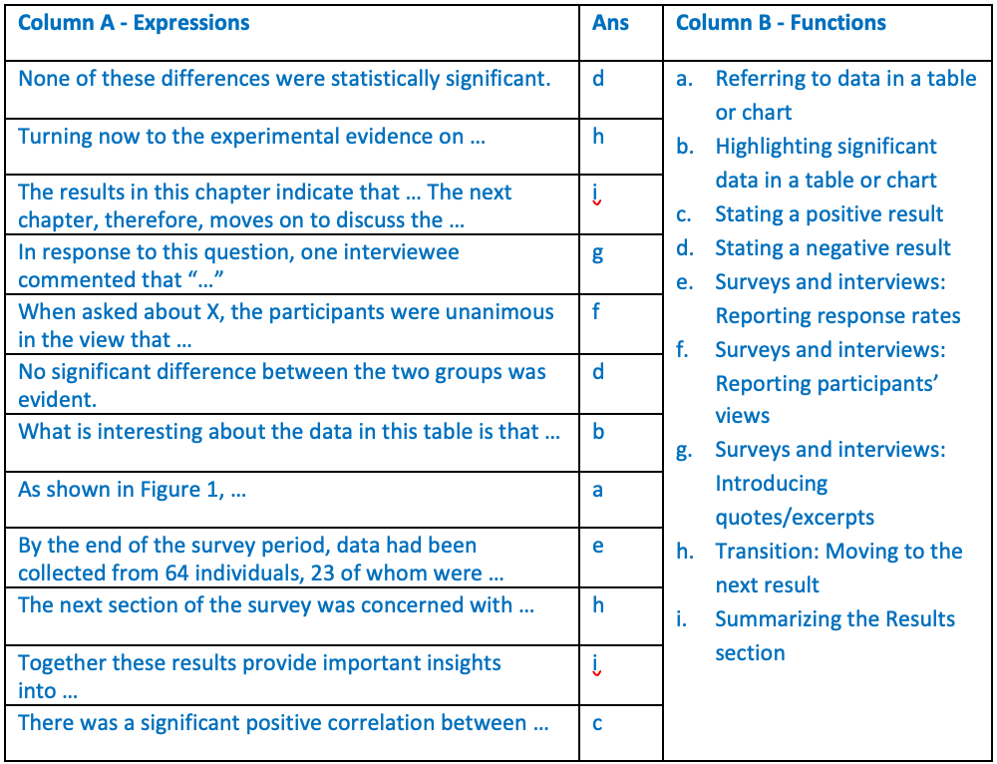
Task 6
Useful Phrases for Reporting Research Results
Column A below shows some commonly used expressions for reporting research results. Match them with the functions in Column B. Some answers can be repeated.
Please visit the Academic Phrasebank for more expressions for reporting research results: http://www.phrasebank.manchester.ac.uk/reporting-results/

Slide 34
Task 7
You are going to watch a video on “Writing a Discussion Section” produced by the Department of English of City University of Hong Kong. Read the questions below before watching. Take notes while you are watching. Then, use the notes to answer the questions below.
Writing for Sciences https://www.youtube.com/watch?v=IkAYXKiWek4
Writing in Social Sciences and Humanities https://www.youtube.com/watch?v=eDKIJ7zx_uw
What is the function of the “Discussion” section in a research paper and a thesis?
Tell the significance of the results, but how to do it depends on the nature of the research and the topic.

Slide 35
Task 7
What are the common ways to discuss the research results as suggested in the video?
Refer to the research questions, hypotheses or objectives which are initially presented in the introduction.
Highlight the principal findings
Explain how your findings relate to earlier research (e.g. your findings confirm existing knowledge on the topic OR your findings challenge earlier research) OR draw readers’ attention to results which are new.
Suggest explanations for the findings
Identify questions for future research
Suggest practical uses for the findings

Slide 36
Moderating Claims and Careful Presentation of Claims in the Discussion Section/Chapter
In order to make your writing credible and persuasive, you need to be aware of how a reader will evaluate its realism, reasonableness and appropriateness. To achieve this, you need to pay attention to linguistic delicacy (or “fine tuning”) of expression. The way in which you reveal your stance contributes to author positioning. There are three main types of devices to reveal your stance: Hedges (e.g. it is likely that), attitude markers (e.g. I think) and boosters (e.g. Clearly, there is a need to). Among the three devices, hedging is the most important one.

Slide 37
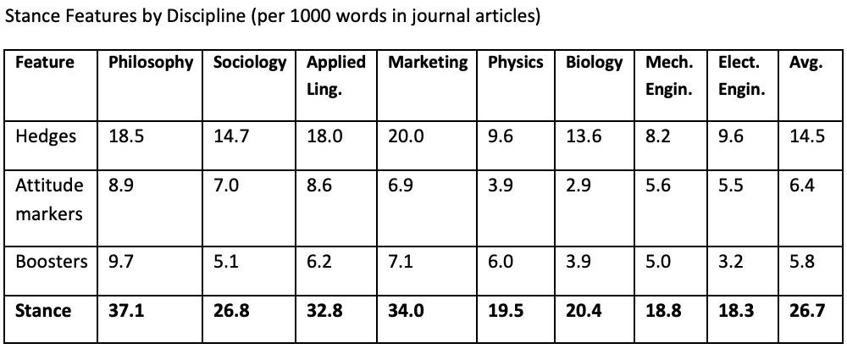
Moderating claims and careful presentation of claims is a characteristic of all fields – even those that are thought to deal with objective facts according to Hyland’s (2004) research:

Slide 38
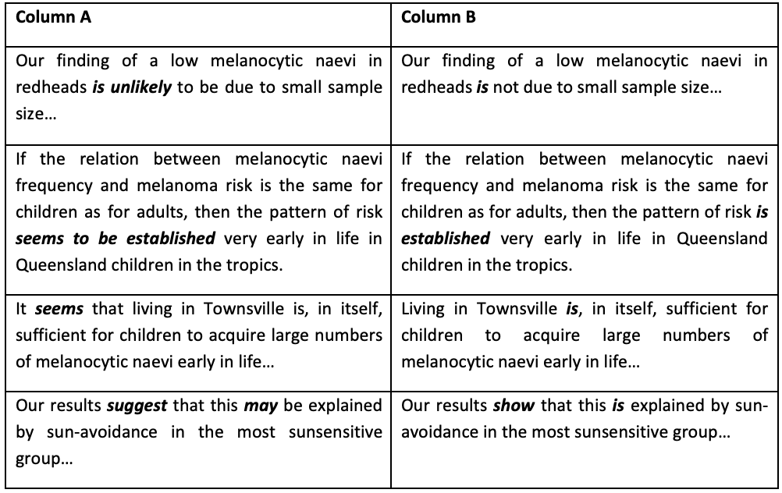
Task 8
Compare the statements in Columns A and B below. Discuss the impact of hedging devices.

Slide 39
Hedging Devices
There are a number of hedging techniques. They are the use of verbs, modal verbs, adverbs, adjectives, nouns and generalization.
1. Verbs
  The following “hedging” verbs are often used in academic writing:
  suggest, indicate, estimate, assume, point to
  The verbs appear and seem are used when a writer wishes to “distance” himself/herself from the findings (and therefore avoid making a strong claim).
  Note that the writer also “protects” himself/herself by using the phrase on the evidence of. These expressions are used in a similar way: according to, on the basis of, based on.
2. Modal verbs
  Another way of appearing “confidently uncertain” is to use modal verbs such as may, might, could and can.
3. Adverbs
  The following adverbs are often used when a writer wishes to express caution:
  probably, potentially, possibly, perhaps, maybe, relatively, apparently, arguably, seemingly, presumably, conceivably, comparatively

Slide 40
4. Adjectives
  Another technique is to use an adjective:
  probable, possible, uncertain, (un)likely, plausible, reasonable
5. Nouns
  The following nouns are often used in academic writing:
  probability, possibility, assumption, evidence, likelihood, claim, potential
6. Generalization
  There are several ways in which you can qualify a generalization.
  (i). You can use the verb tend or the noun (have/be a) tendency (to).
  (ii). You can use an adverb such as: generally, largely, primarily, for the most part, predominantly, mainly, usually, to a greater extent

Slide 41
Task 9
Underline the verb that makes the weaker claim.
The results (indicate/establish) that there is a link between smoking and lung cancer.
The survey results (suggest/show) that the reuse of sentences on sections from one’s previously published papers is a questionable practice.
The latest series of studies (question/challenge) the value of including consumer expectations in the assessment of service quality.
The results given in Figure 4 (validate/support) the second conclusion that certain bacteria can reduce arsenic (As) levels in groundwater.
Baseline conditions have been (assumed/shown) to be accurate at the time of the surveys.
Several studies have (identified/alluded to) the importance of cultural sensitivity as a precursor to culturally appropriate medical care.
Changes in ambient temperature may have (influenced/distorted) the test results.
Figure 10 (depicts/clarifies) the relationship between these two systems.

Slide 42
Task 9
Underline the verb that makes the weaker claim.
The results (indicate/establish) that there is a link between smoking and lung cancer.
The survey results (suggest/show) that the reuse of sentences on sections from one’s previously published papers is a questionable practice.
The latest series of studies (question/challenge) the value of including consumer expectations in the assessment of service quality.
The results given in Figure 4 (validate/support) the second conclusion that certain bacteria can reduce arsenic (As) levels in groundwater.
Baseline conditions have been (assumed/shown) to be accurate at the time of the surveys.
Several studies have (identified/alluded to) the importance of cultural sensitivity as a precursor to culturally appropriate medical care.
Changes in ambient temperature may have (influenced/distorted) the test results.
Figure 10 (depicts/clarifies) the relationship between these two systems.

Slide 43
Task 10
Identify expressions that demonstrate the language features or rhetorical functions listed in Column A, as used in the Discussion section of journal articles from your discipline. Record these expressions in Column B.
Column A | Column B
Interpreting the results
Comparison with previous studies
Discussion of real-world applications or theoretical contributions
Stating the limitations and future directions
Use of hedging language

Slide 44
Checklist for a Well-Written Discussion:
Does it clearly interpret the results in relation to the research questions/hypotheses?
Are comparisons to existing literature included?
Are the research limitations acknowledged?
Are implications, potential applications and future directions discussed?
Is the discussion section free from overgeneralisations and unsupported claims?

Slide 45
Independent Learning: Using Corpora to Improve Academic Writing
Continue to use your personal corpora to do linguistic search!
Video 6: Search for Collocations (table) (~4 minutes)
https://youtu.be/qGILwdSnJlM
Video 7: Search for Collocations (difference) (~3 minutes)
https://youtu.be/8nftcikpzMs
Video 8: Improve your writing with BNCweb (concern) (~6 minutes)
https://youtu.be/yOkH87Xph50

